Slide 1
SSW-810: Software Engineering Tools and Techniques
Testing and Debugging
Prof. Jim Rowland
Software Engineering
School of Systems and Enterprises

Slide 2
Acknowledgements
This lecture includes material from
“How to Think Like a Computer Scientist: Learning with Python 3 (RLE)”, Peter Wentworth, Jeffrey Elkner, Allen B. Downey, and Chris Meyers,
http://openbookproject.net/thinkcs/python/english3e/
“Introducing Python”, Bill Lubanovic, ISBN-13: 978-1449359362
http://proquest.safaribooksonline.com/book/programming/python/9781449361167
“Python Testing Cookbook“, Greg L. Turnquist, ISBN-13: 978-1849514668
https://docs.python.org/dev/library/unittest.html

Slide 3

Today’s topics
Testing
Test Driven Development
Testing triangle classification
Unittest framework
Debugging functions
Debugging with print
Debugging with VS Code

Slide 4
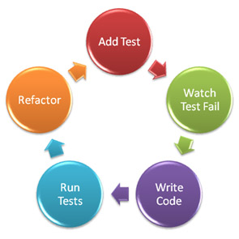

Test Driven Development
Write tests before you write the code
Test Driven Development (Kent Beck)
eXtreme Programming Agile Method
Writing the test helps you to think about the problem and write better code
https://assertselenium.files.wordpress.com/2012/11/tdd_cycle.jpeg

Slide 5

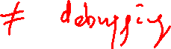
Software testing
The goal of software testing is to determine if the implementation meets its specifications
Does it do what it’s supposed to do?
Testing and debugging are related, but different tasks
Testing identifies problems – debugging fixes problems

Slide 6

Testing triangle classification
Equilateral: all three sides have the same length
Isosceles: exactly two sides have the same length
Scalene: sides have the three different lengths
b
Right: a² + b² = c²
a
c

Slide 7
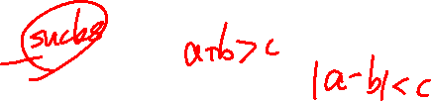
Requirements
“Write a function classify_triangle() that takes three parameters: a, b, c representing the lengths of the sides of a triangle. Return a string that specifies whether the triangle is scalene, isosceles, or equilateral, and whether is is a right triangle as well.”
Are these good requirements?
Are they complete?
What’s missing from the requirements?

Slide 8

Test the Requirements
“Write a function classify_triangle() that takes three parameters: a, b, c representing the lengths of the sides of a triangle. Return a string that specifies whether the triangle is scalene, isosceles, or equilateral, and whether is is a right triangle as well.”
Define the return values – important for code reuse with APIs
Define boundary conditions: min/max values, e.g. > 0
Resolve precedence ambiguity with right vs. scalene triangles
Every right triangle is also a scalene triangle
Include definition of a valid triangle:
Sum of any two sides < third side
The sides may be specified in any order
Don’t assume side, side, hypotenuse order
Other improvements?
a
b
c

Slide 9
When are we done testing?
What kinds of tests must we include?
How many tests must we include?
How do we know when we’ve adequately tested the function?

Slide 10
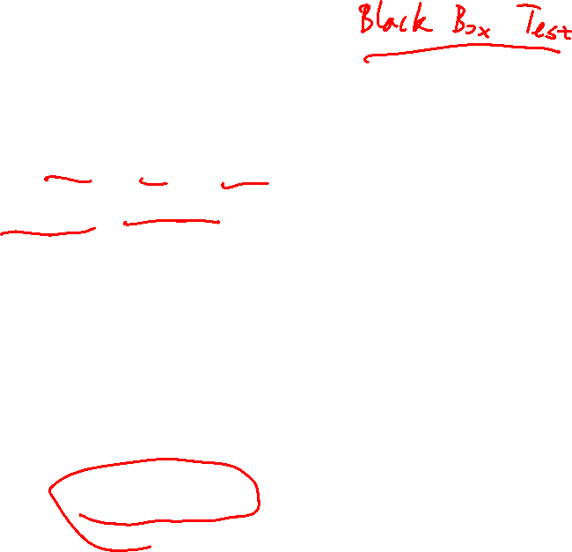
Testing Strategies
Complete coverage, i.e. test all possible combinations?
Might be possible with a small range but typically not feasible
Choose a subset of values to test
Test each feature at least once
Test expected case
Test “around the edges”
What might we have missed?
Include both positive and negative tests
Positive: valid input produces valid output
Negative: invalid input is handled gracefully
Beware that tests can have bugs too!

Slide 11


What should we test?
Valid & invalid input parameters
Negative numbers, floats, strings, …
Boundary conditions
E.g. min value, max value
Equivalence classes
There are many integers and floats
We can’t possible test all of them
Test each possible output case
Test parameter order invariance
classify_triangle(3,4,5) == classify_triangle(5,3,4)

Slide 12
Boundary conditions
Example: an integer x is valid from from a to b
a-1 a b b+1
Important test cases occur… | Test cases
At the boundary | a, b
A little before the boundary | a – 1
A little after the boundary | b + 1
Check < vs <= and > vs >= carefully!

Slide 13
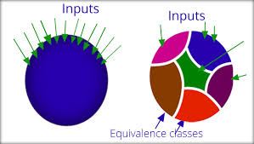
Equivalence classes
We can’t test all possible values
e.g. all float values between 0 and 1
Partition the range of values into equivalence classes, i.e. sets that we expect to behavior similarly
Use one value from the equivalence class to test all values from the equivalence class

Slide 14
Equivalence classes
Example: an integer x is valid from from a to b
a-1 a b b+1
Equivalence Classes
Valid: a <= x <= b
Invalid: x < a; x > b
Invalid: x not an integer
Equivalence Class test cases
Valid value from equivalence set, e.g. a or b
Invalid too small
Invalid too big
Some non-integers ($, !@, A)

Slide 15
Boundary conditions for classify_triangle
Boundary conditions
a, b, c must be numbers (integers or floats)
a > 0, b > 0, c > 0
Upper limits?
Sum of any two sides > third side → Invalid triangle

Slide 16
Equivalence classes for classify_triangle
Case | Equivalence class
Valid inputs | Integers/floats > 0
Invalid inputs | Strings, integers/floats <= 0
Equilateral, Isosceles, Scalene | Any 3 numbers, > 0, all three the same
Equilateral, Isosceles, Scalene | Any 3 numbers, > 0, two the same, one different
Equilateral, Isosceles, Scalene | Any 3 numbers, > 0, all three different
Right/Scalene | Any 3 numbers, > 0, a² + b² = c²
Right/Isosceles | Any 2 numbers, > 0, a² + a² = c²

Slide 17
Test cases for classify_triangle
Test | Inputs | Expected output
Invalid inputs | ‘hello’, 1, 1 -1, -1, -1 0, 0, 0 1, 1, 3 | Error Error Error Not a triangle
Equilateral | 3.0, 3.0, 3.0 | Equilateral
Isosceles | 2, 2, 3 | Isosceles
Isosceles/Right | 2, 2, 2.828 (sqrt(8)) | Isosceles Right
Scalene | 3, 4, 6 | Scalene
Scalene/Right | 3, 4, 5 | Scalene Right
Note: the order of the arguments to classify_triangle should not change the result but it is important to verify.
Repeat all of the valid input tests with the same inputs in different orders.

Slide 18

How to implement and run the tests?
We’ve defined the tests we need for classifying triangles
How should we run the tests?
I’m a hacker! I don’t need tests!
Manually?
Not feasible in changing production environment
Automated testing is critical
Even for homework assignments!

Slide 19

Unittest Overview
xUnit is a popular framework for software testing
pyUnit/unittest, jUnit, C Unit, C++ unit, …
Write test cases along with (before) your code
Invoke the test cases
Define Test Harnesses and Test Cases
Unittest manages running the tests
Use inheritance to derive a test case from unittest
Test a class or procedural code

Slide 20
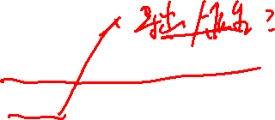
Simple Unittest recipe
import unittest
Derive a class fooTest from unittest.TestCase for the class/feature foo being tested (the test class name is arbitrary)
Define a set of methods inside fooTest for each test case
Each test case includes calls to unittest.TestCase.assert*() methods
Method name should begin with ‘test_’
Call unittest.main()
unittest.main()automatically invokes all of the methods in all classes derived from unittest.TestCase
Debug and fix bugs in test cases and code
Repeat until all tests pass

Slide 21
Unittest Assert Methods
Method | Checks
assertEqual(a, b, msg=None) | a == b
assertNotEqual(a, b, msg=None) | a != b
assertAlmostEqual(a, b, places=7,msg=None) | round(a-b, places) == 0
assertNotAlmostEqual(a, b, places=7,msg=None) | round(a-b, places) != 0
assertTrue(v, msg=None) | bool(v) is True
assertFalse(v, msg=None) | bool(v) is False
assertIs(a, b, msg=None) | a is b
assertIsNot(a, b, msg=None) | a is not b
assertIsNone(v, msg=None) | v is None
assertIsNotNone(v, msg=None) | v is not None
assertIn(a, b, msg=None) | a in b
assertNotIn(a, b, msg=None) | a not in b
assertIsInstance(a, b, msg=None) | isinstance(a, b)
assertNotIsInstance(a, b, msg=None) | not isinstance(a, b)
assertRaises(Exception, function, [function args]) | Exception is raised
Source: https://docs.python.org/dev/library/unittest.html

Slide 22
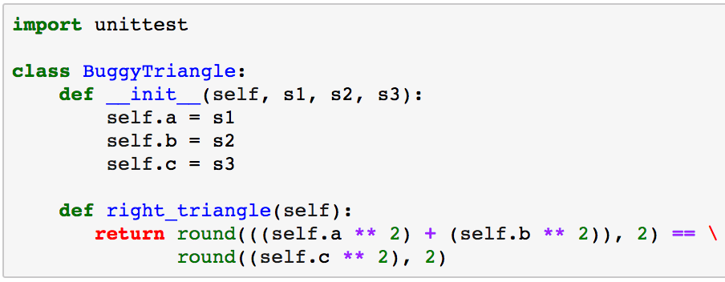
BuggyTriangle Code
Make unittest available to the program
Define the new class

Slide 23
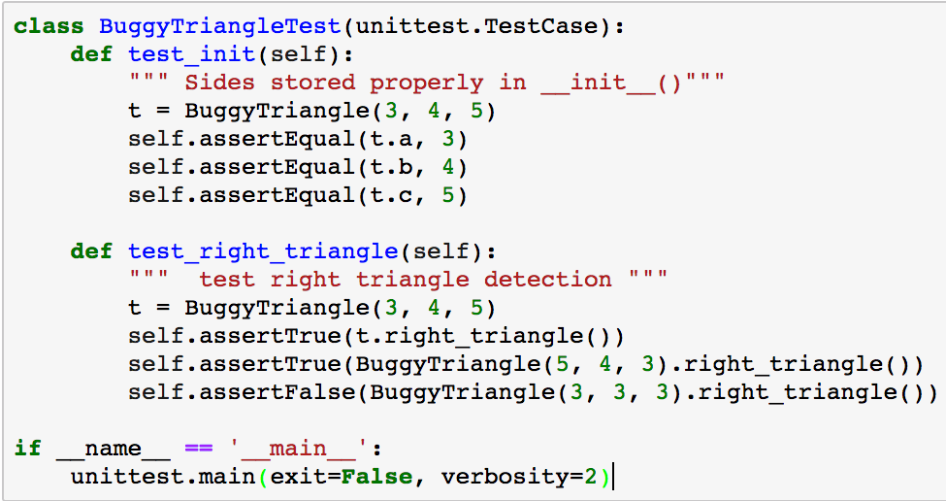
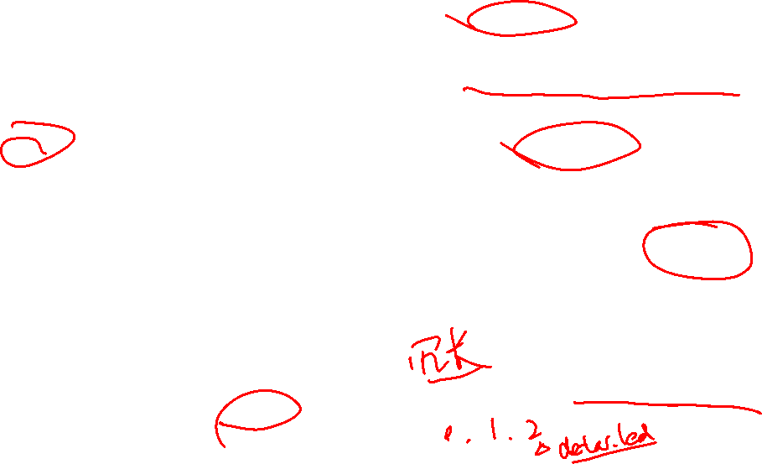
BuggyTriangle Test Code
Derive a class from unittest.TestCase
Method name must begin with ‘test_’
Docstring is important for debugging
Test method can include any code plus assert* methods
Add as many test cases as needed
Run the test cases
Specify verbosity of test output

Slide 24
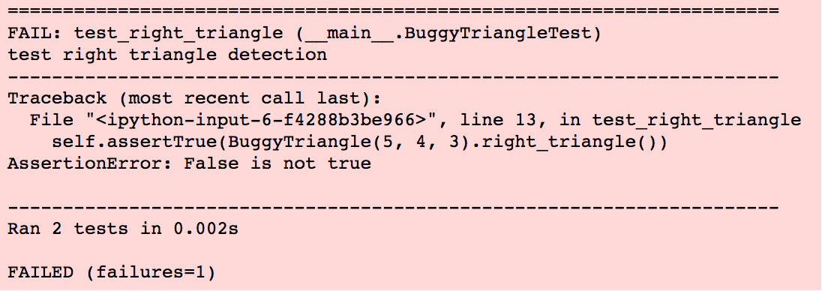
BuggyTriangle test output
Docstring from the test case
Click on the line to go directly to the code
Ran 2 tests, 1 failed
A test is one method with arbitrary number of assert* statements

Slide 25
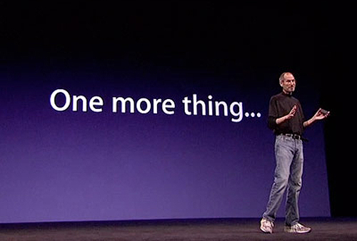

Slide 26
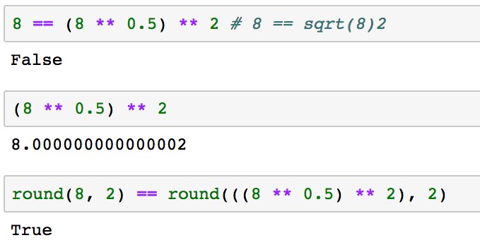

Comparing floats
assertAlmostEqual(a, b, places) ???
Be aware that computers don’t perfectly represent floating point numbers
WHAT???
round(n, places) eliminates precision but leads to expected results.
Be careful with the level of precision that is appropriate for your application

Slide 27
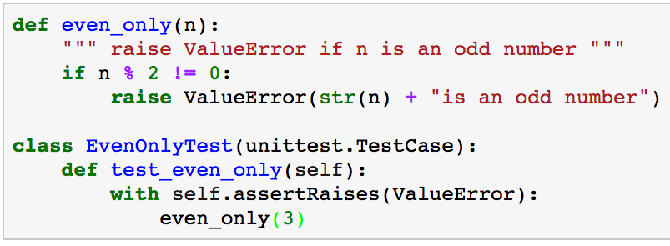
Testing Exceptions with unittest
Calling even_only(3) should raise ValueError

Slide 28
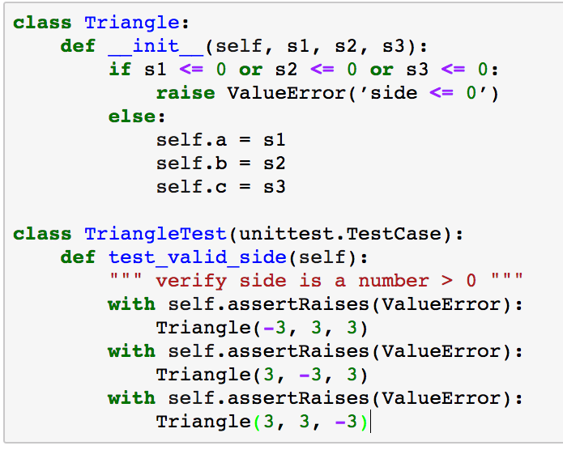
Testing Exceptions with unittest
Creating an instance of Triangle with any side <=0 should raise ValueError

Slide 30
Writing test cases
Not everyone uses Test Driven Development when writing code or perhaps the tests are incomplete
(or homework assignments may require you to write tests ;-)
You may be asked to add to the test suite of code you didn’t write
Good testers are invaluable
Good test cases are as valuable as good code
Good code without test cases is hard to trust

Slide 31
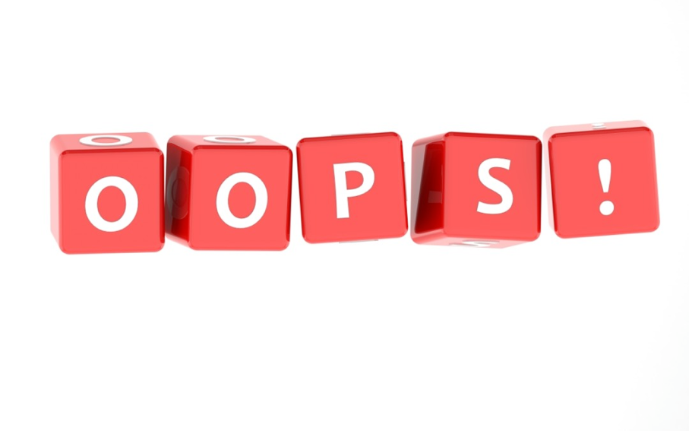
What can go wrong?
Logic/code errors
Misunderstood/unclear requirements
Unexpected parameter values
Boundary conditions
Incomplete test suites
Others…

Slide 32
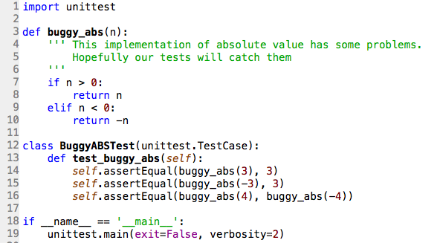
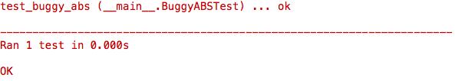

Test boundary conditions: abs(n)
Boundary conditions: negative, 0, positive
Tested positive and negative numbers
→ All tests passed! But wait:
What’s buggy_abs(0)? None Why?
We need to add a test for buggy_abs(0) == 0

Slide 33
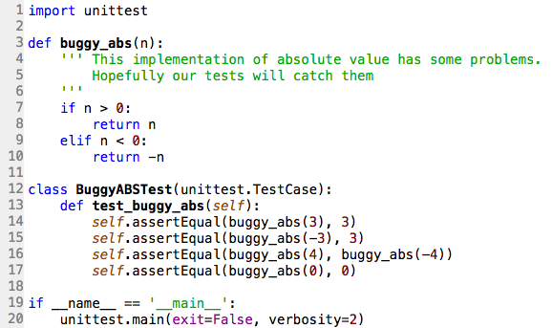
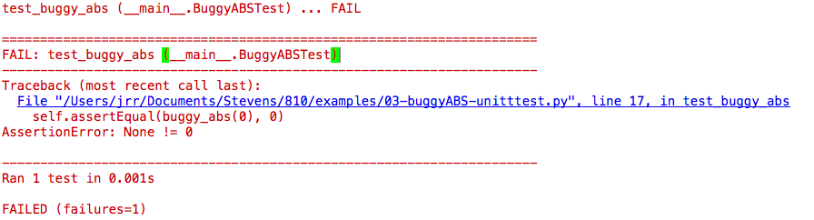
Test boundary conditions: abs(n)
Boundary conditions: negative, 0, positive
Added missing test case
We added the test for buggy_abs(0) and our test suite correctly points out that we have more work to do.
We’ll talk about that in the next section.
Test shows we have a problem

Slide 34

Testing Strategies
Test each function
Test expected case
Test boundary conditions and “around the edges”
What might have been missed?
Include both positive and negative tests
Positive: valid input produces valid output
Negative: invalid input is handled gracefully
Beware that tests can have bugs too!
Missing important tests
Bugs in the test case

Slide 35


Slide 36

Debugging
We’ve explored how we can use test cases to identify bugs in new and existing functions
Once we know there’s a bug, how do we fix it?
What tools and techniques can we use?
Debugging is hard, but there are tools to help
Trying to find problems without debugging tools is like trying to find a needle in a haystack

Slide 37
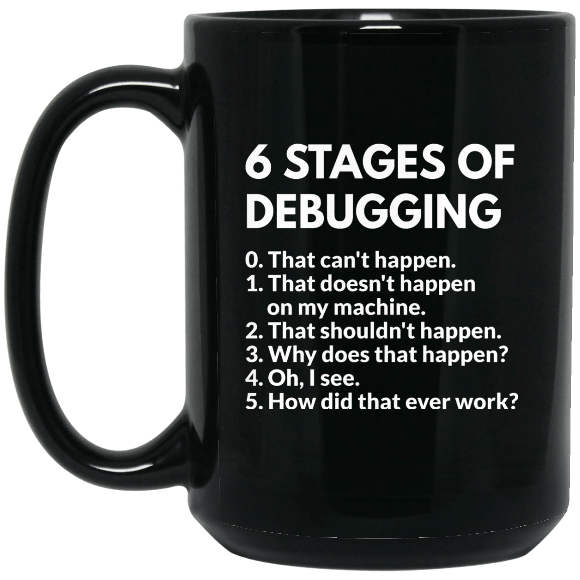
Just for fun

Slide 38

Debugging is hard
“Everyone knows that debugging is twice as hard as writing a program in the first place. So if you’re as clever as you can be when you write it, how will you ever debug it?” -- Brian W. Kernighan

Slide 39
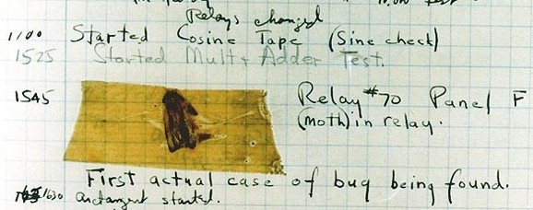
The first (but not the last) bug
The first bug was found by Admiral Grace Hopper at Harvard University in 1947 – a moth that impacted the hardware
http://www.computerhistory.org/tdih/September/9/

Slide 40
Test boundary conditions: abs(n)
Boundary conditions: negative, 0, positive
Something is wrong with the logic for 0. How do we find it and fix it?

Slide 41

3 Steps to debugging
Step 1: Recognize that there is a problem (testing is one solution)
Step 2: Find the cause of the problem
Step 3: Fix the problem without breaking anything else
Automated testing helps to verify that the fix didn’t break anything
All three can be challenging! That’s why good software engineers are in such high demand (and earn such high salaries ;-)

Slide 42
Debugging techniques
Once you know there is a bug, how do you find it?
Approach | Advantages | Disadvantages
Read the code | Code reviews are the most effective way to find problems | Difficult and time consuming, especially with unfamiliar, or large code. Most effective with highly experienced readers
Print statements | Simplicity – anyone can do it. | May be difficult to add enough print statements at the right place to be efficient. Must remove print statements
Static code analyzers | No code changes needed. Helps to find “silly”, but subtle errors | None
Debuggers | Fast, efficient, thorough | Small learning curve, but it’s a skill that will save countless hours

Slide 43

Debugging: Read the code
Test suite identified a problem
Test suite identified a problem
Testing reports bug when n == 0. Read the code to see if we can find the problem.
AH HA!!! The logic handles < 0 and > 0 but not 0.
Now we know the problem. Next, how to solve it?

Slide 44
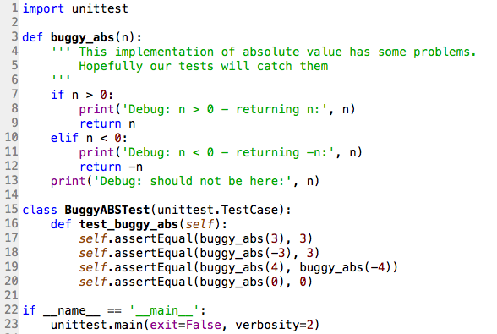
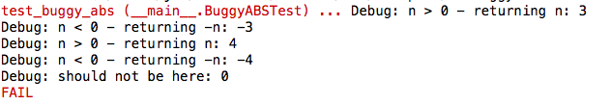
Debugging: Add print statements
Test suite identified a problem
Testing reports a bug when n == 0. Added print statements to help to understand what’s happening.
AH HA!!! The logic handles < 0 and > 0 but we fall off the end of the function with 0.
Now we know the problem. Next, how to solve it?
Oh yeah, don’t forget to remove those print statements when we’re done!

Slide 45

Fixing the problem
The test suite identified a problem
We read the code and used print statements to understand that 0 falls through the if/else statement and the function is returning None
Solution: change the if statement to handle the 0 case

Slide 46
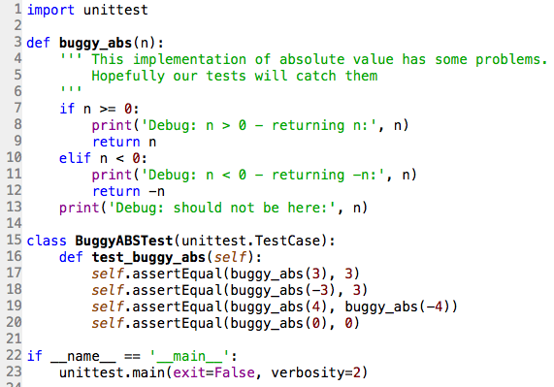
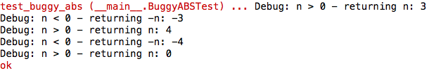
Verify our change
Did our change fix the problem? Did we break anything else?
All tests pass after our fix!
Oh yeah, don’t forget to remove those print statements!
Changed > to >=

Slide 47
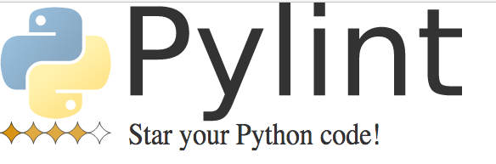
Debugging tools: Static code analysis
Tools read your Python code and report “violations”
Syntax errors
Uninitialized variables
Undefined functions
Coding style violations
Measures coding standards compliance and assigns a score
We’ll focus first on Pylint integration with VS Code

Slide 48
Debugging tools: Debuggers
Set breakpoints in the code to pause execution and explore
Step through code line by line
Step into function calls/Step out of function calls
Watch variables as they change values during execution
Evaluate arbitrary expressions
Investigate the call stack, i.e. which functions called what

Slide 49
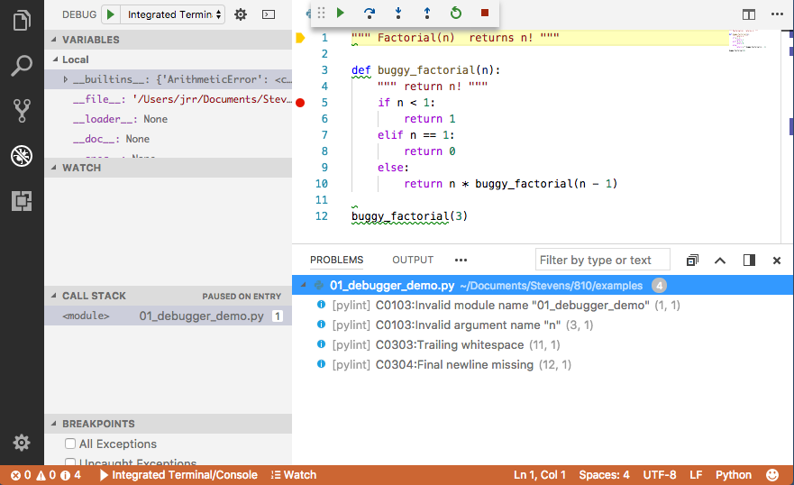
Debugging tools: VS Code
Debugger Commands
Choose ”Integrated Terminal” by default
Code window
Debug File
Stack Trace
Pylint warnings and errors

Slide 50
Debugging tools: VS Code
Debugger Commands
2. Choose ”Integrated Terminal” by default
3. Load file
1. Show debugger Windows
4. Pylint warnings and errors

Slide 51
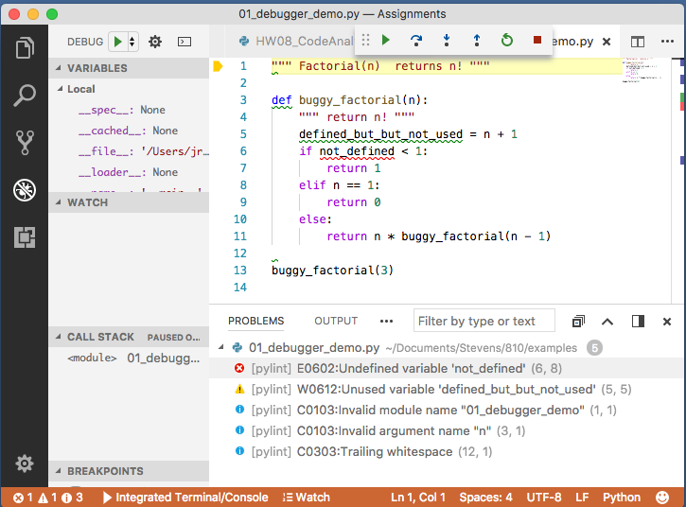
Debugging tools: Code warnings
Underlines identify suspicious code
Details in the “PROBLEMS” tab

Slide 52
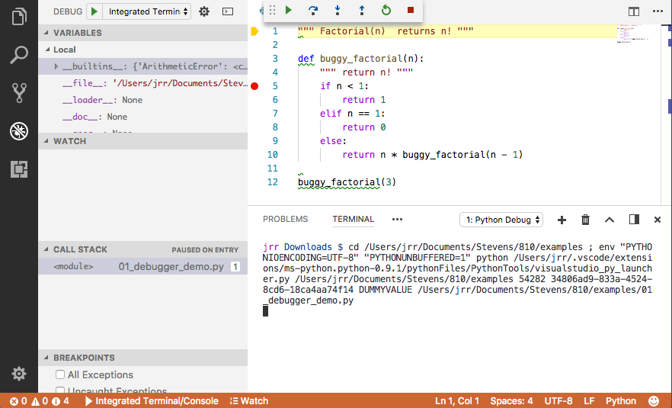
Debugging tools: VS Code
Set/Clear Breakpoints
Run, step over, step into, step out of, rerun, stop
Variable Browser
Code window
Program input and output
Python Console

Slide 53
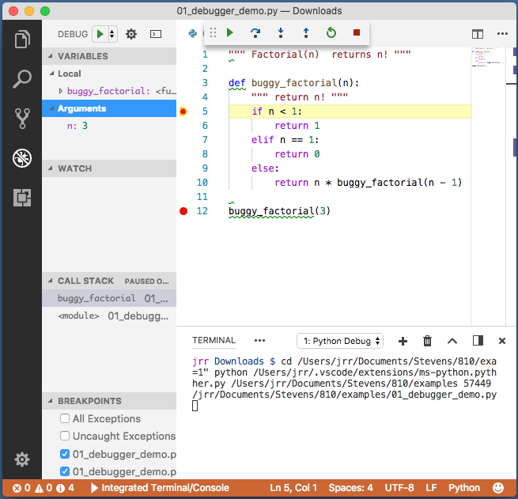
Debugging Commands
Run File
Run Current Line
Set Breakpoint
Double click left of the line number to set breakpoint
Debug File
Run the file and stop at first breakpoint
Run Current Line
Execute current line
Step into function
Execute current line and step into function calls
Step Into Function
See variable values
Breakpoints

Slide 54
Debugging Commands
Continue Execution
Step out of function
Continue execution and return to calling function
Debug File
Run the file and stop at first breakpoint
Continue Execution
Continue execution until next breakpoint
Exit Debug
Stop debugging
Exit Debug
Step Out of Function
Watch arbitrary expressions

Slide 55
Debugging: Typical session
Set a breakpoint or two
Debug File (run debugger)
Step across/into/out of function calls
Evaluate variables
Variable Explorer
Stop and think about what’s happening and why

Slide 56
Live Debugger Demo: VS Code
Debugger Commands
Choose ”Integrated Terminal” by default
Code window
Debug File
Stack Trace
Pylint warnings and errors

Slide 57
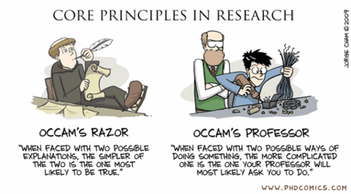
Occam’s Razor for debugging

Slide 58
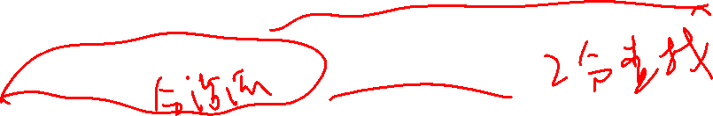
Debugging Heuristics and Strategies
Divide and Conquer/Binary search
Minimize and isolate the code and data being debugged
New code is more likely to have bugs than older code
Try to get back to a working state
Boundary cases are always suspect
Beware of integration points with other modules and code authors
Check the easy things first, e.g. silly mistakes
Learn from your mistakes so you don’t make them again

Slide 59
Divide and Conquer/Binary Search
Goal is to isolate the problem to minimize the places the bug can be hiding
Remember, the bug may be in the code or the data
Cut the search space in half and try to isolate the problem to one half or the other
10
5
15
2
7
12
17
1
3
6
8
11
13
16
18
4
9
14
19

Slide 60
Guess a number between 1 and 20
Pick a number near the middle and split in “half”
10
Pick a number near the middle and split in “half”
Pick a number near the middle and split in “half”
5
Pick a branch based on “too high” or “too low”
15
2
7
12
17
1
3
6
8
11
13
16
18
4
9
14
19

Slide 61
Cut the search in half, test, repeat…
Isolate the problem to half of the problem space
Reduce the code
Reduce the data
Reduce the space we need to search

Slide 62

Questions?

